Slide 1

ELECTRICITY BILLING SYSTEM
A
Java Spring Boot Project
as
Submitted by
Under The Trainee
By
Vaishali Amrutia
1. Balaguru N

Slide 2

Abstract
The main objectives of the Electricity Billing System is to manage the details of Electricity Bill, Connections, Store Data, Customer Details, Bill History.
It manage all the information about Electricity, customer details, Electricity Bill.
The project is totally built by Admin end and thus only the Admin is guaranteed the access.
The purpose of the project is to build an application program to reduce the manual work for managing the Electricity, Bill, Electricity Boards.
It tracks all the details about the Customers and Bill Details.

Slide 3

Modules of project
Admin Module
Registration Module
User Module
Billing Module
Payment Module
Details of User Module

Slide 4
Software Requirements
Back-end & Database
Front-end & server
Java JDK version-18
MySQL
Spring Boot
HTML
CSS
Tomcat
Thymeleaf
Tools
Spring tool suite

Slide 5
Features in this project
To increase efficiency of managing the Electricity Bill.
Editing, adding and updating of Records in the customer details and Billings.
Manage the information of Bill.
Admin can add any new bills on the website.
we can also view the History of our bills.
In our project the a Button in Home page is called Quick Pay.

Slide 6
Advantages
The system excludes the need of maintaining paper electricity bill as all the electricity bill records are managed electronically.
Administrator doesn't have to keep a manual track of the users. The system automatically calculates fine.
The system excludes manual bill calculation.
Users don’t have visit the office for bill payment.
There is no need of delivery boy for delivering bills to users place.
Thus, it saves human efforts and resources.

Slide 7
Disadvantage
Users must have a reliable internet connection.
There is no human interaction if users have some enquiry.
Application
This system can be used in electricity providing departments.

Slide 8
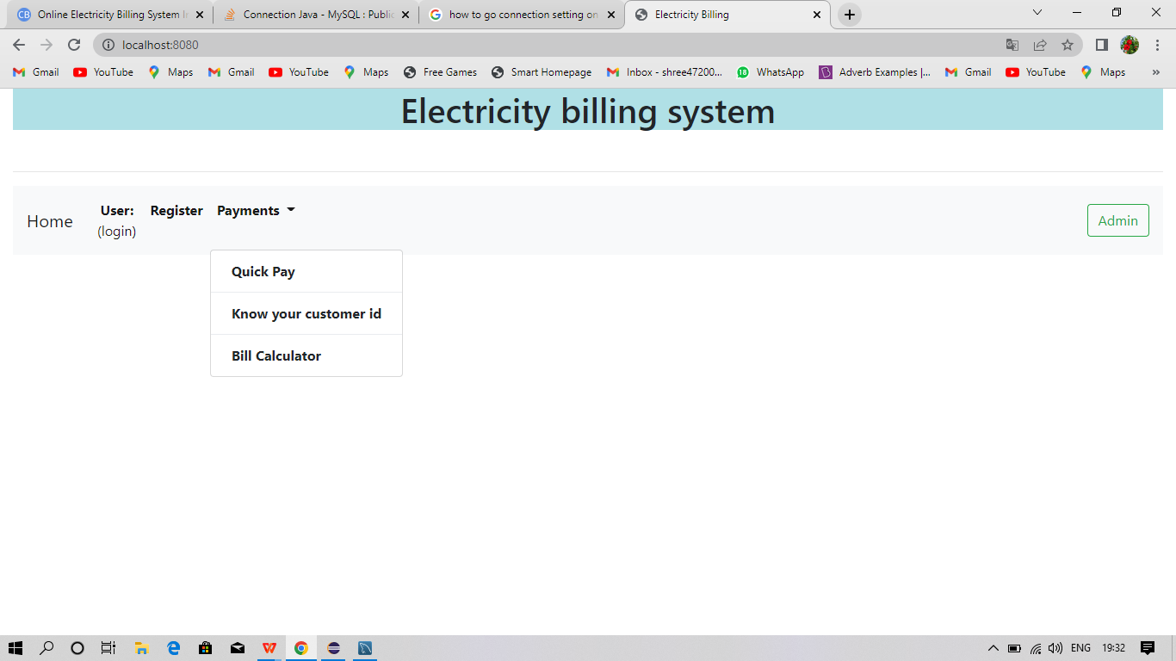
Web Server Page
1. Home Page

Slide 9
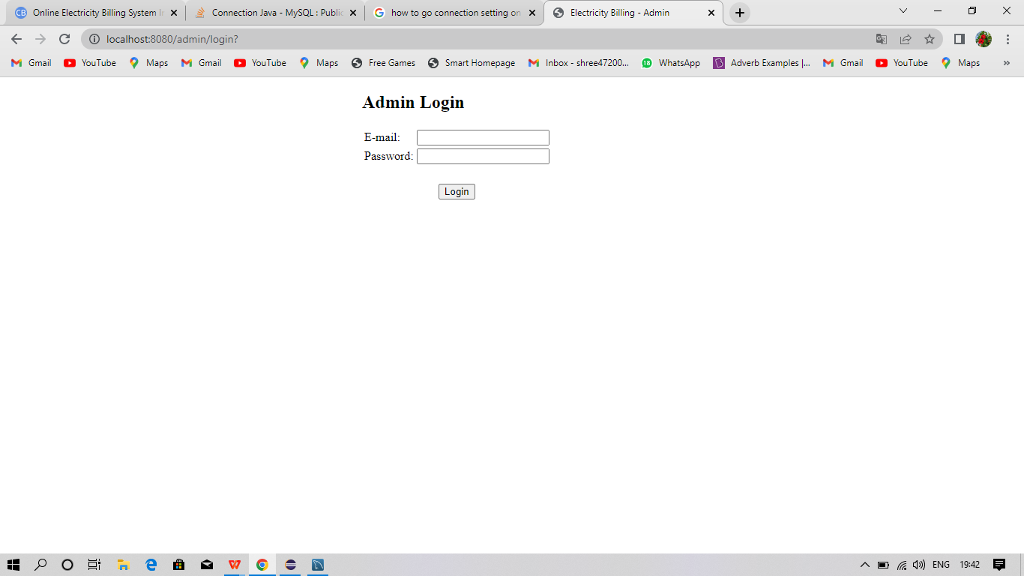
2. Admin login Page

Slide 10
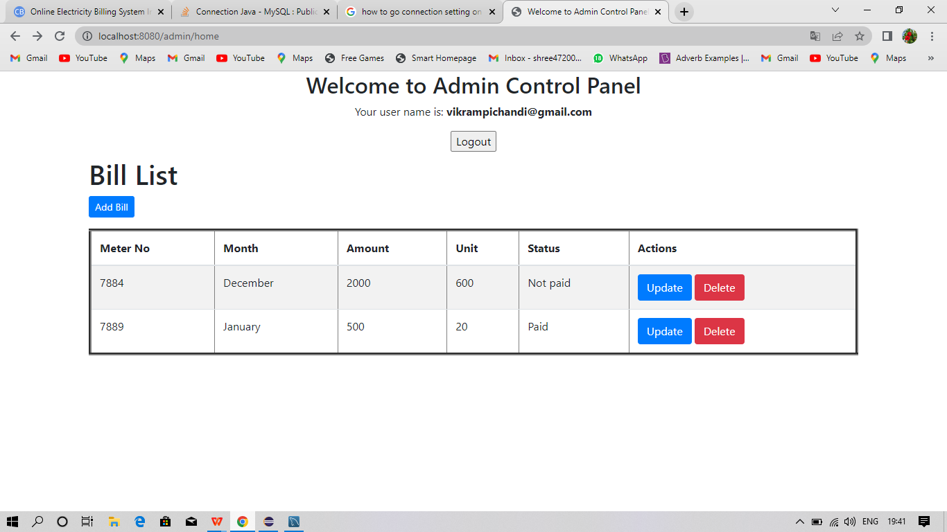
3. Admin Home Page

Slide 11
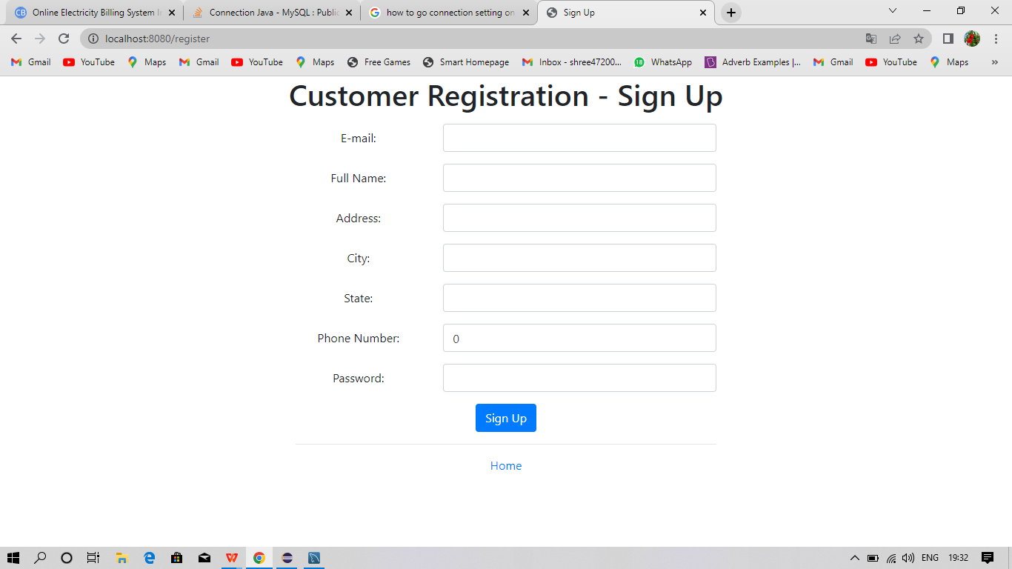
4. Registration page

Slide 12
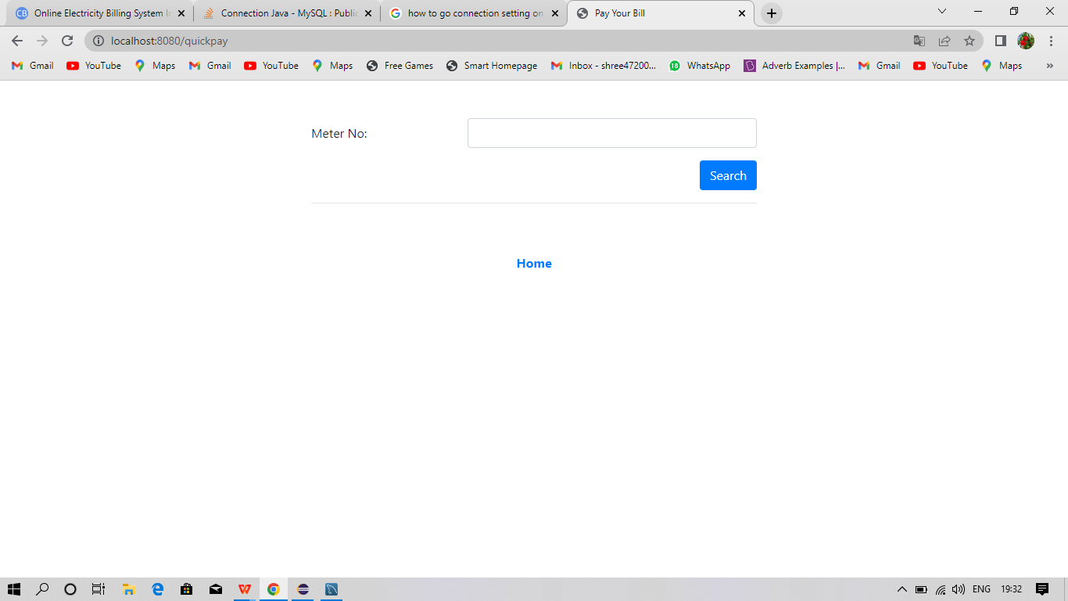
5. Quick Pay Page

Slide 13
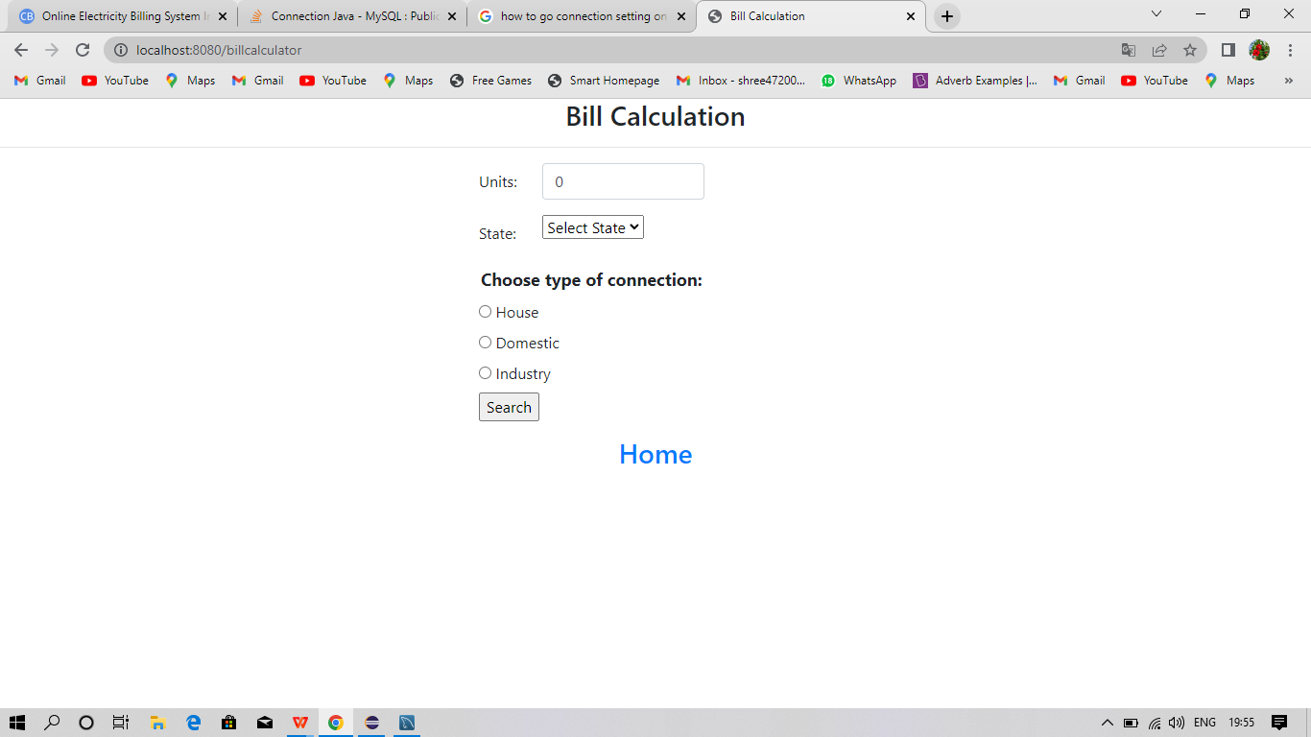
6. Bill Calculation Page

Slide 14
Conclusion
Users must have a reliable internet connection.
In our project we successfully create a spring boot java project of Electricity Billing System.
There in the project we face many issues during the creating of our project.
In the end of the project we got successfully output of the project in the webserver.
This project mainly used to reduce the man power and increase the Technologies.

